Slide 1
Sample Hospital Report Content
EXAMPLE PURPOSES ONLY
Indications, contraindications, warnings, and instructions for use can be found in the product labeling supplied with each device. Risks may include air emboli and infection.
CAUTION: Federal (USA) law restricts these (referenced above) devices to sale by or on the order of a physician
This report is provided based solely on the information provided by the hospital/physician. Please refer to attached table. Osprey Medical intends for this report to be informational in nature only; and is not intended to diagnose, treat or direct patient care.
This product, and its use, may be protected by US Patents and pending applications. DyeVert is a trademark of Osprey Medical, Inc. © Osprey Medical, Inc. 2020 All Rights Reserved. PR0224 rev C

Slide 2
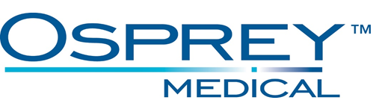
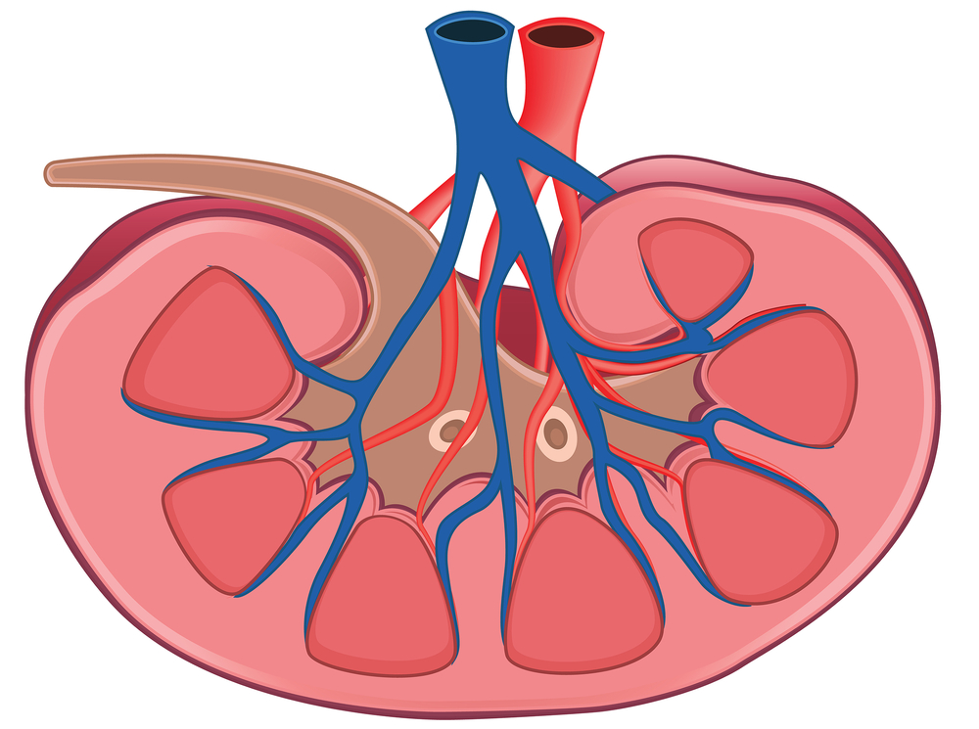
Sample Hospital Report Content
DyeVert Summary – Hospital A
All cases (N=X)
X% avg
Less
Contrast
> Threshold, N=X
< Threshold, N=X
< 1/3 Threshold, N=X
< 2/3 Threshold, N=X
X mL less total
Volume to Patient compared to Threshold (entered), 2/3 Threshold and 1/3 Threshold
Indications, contraindications, warnings, and instructions for use can be found in the product labeling supplied with each device. Risks may include air emboli and infection.
CAUTION: Federal (USA) law restricts these (referenced above) devices to sale by or on the order of a physician
This report is provided based solely on the information provided by the hospital/physician. Please refer to attached table. Osprey Medical intends for this report to be informational in nature only; and is not intended to diagnose, treat or direct patient care.
This product, and its use, may be protected by US Patents and pending applications. DyeVert is a trademark of Osprey Medical, Inc. © Osprey Medical, Inc.2020 All Rights Reserved. PR0224 rev C

